Slide 1
Sales & Customer Insights Analysis Using PostgreSQL & Power BI
by Shivang Sharma

Slide 2
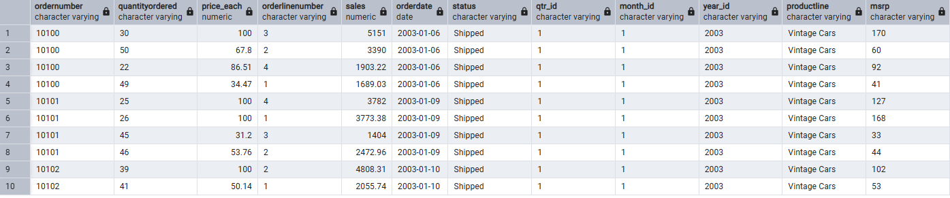
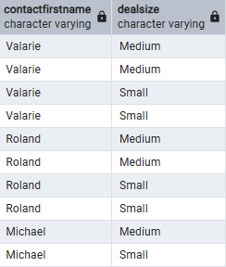
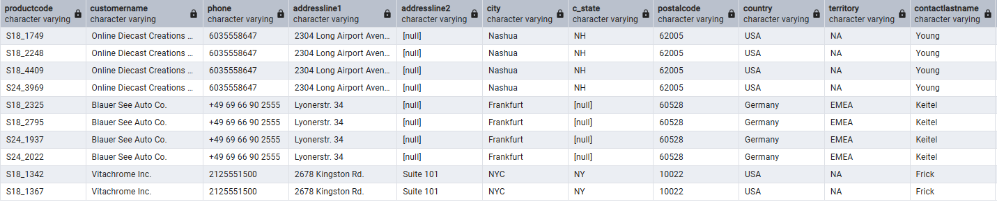
Dataset Overview

Slide 3
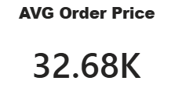
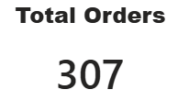
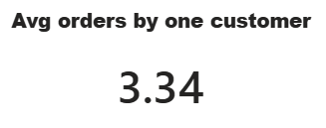
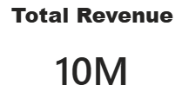

Slide 4
Global Sales analysis

Slide 5
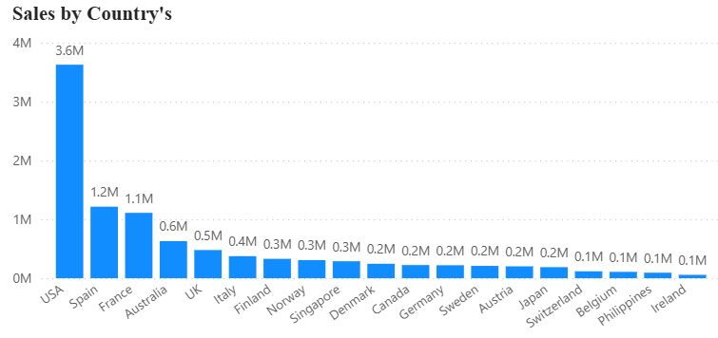
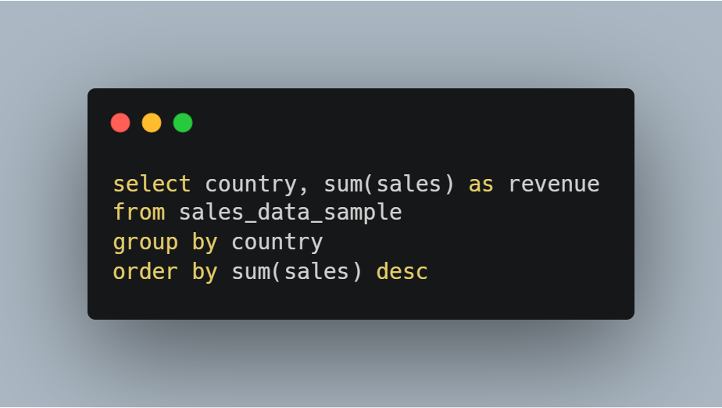
country's
The USA is the highest revenue-generating market, significantly outperforming all other countries.
Spain and France are the next strongest markets, each generating over $1M in revenue.
Several countries show low contribution, indicating untapped growth potential.
Business Implication
Focus on retention and upselling in top markets (USA, Spain, France)
Increase marketing efforts in underperforming regions

Slide 6
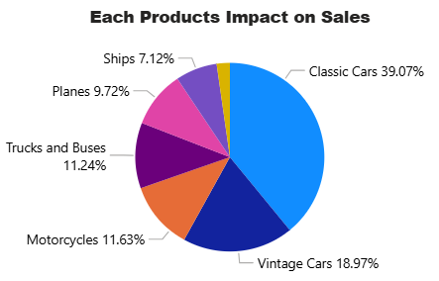
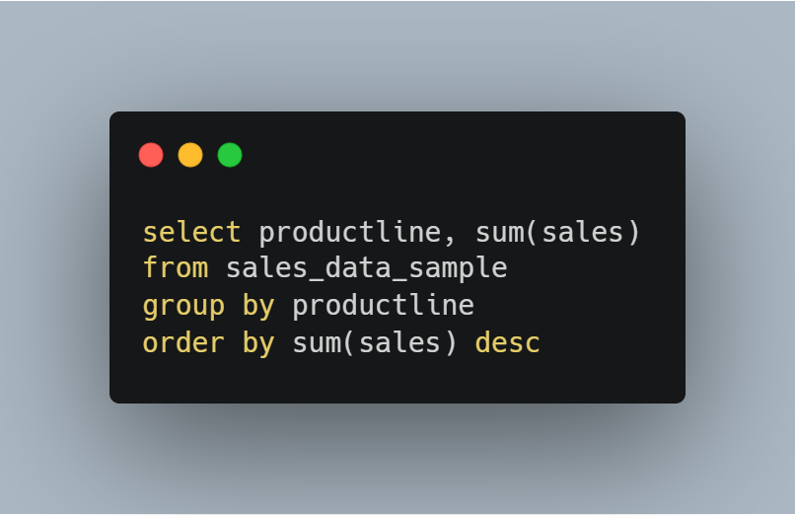
Products
Classic Cars dominate sales, contributing ~39% of total revenue.
Vintage Cars are the second strongest category.
Other categories (e.g., Trains, Ships) show relatively lower performance..
Business Implication
Expand inventory and marketing for high-performing product lines
Re-evaluate or reposition low-performing categories

Slide 7
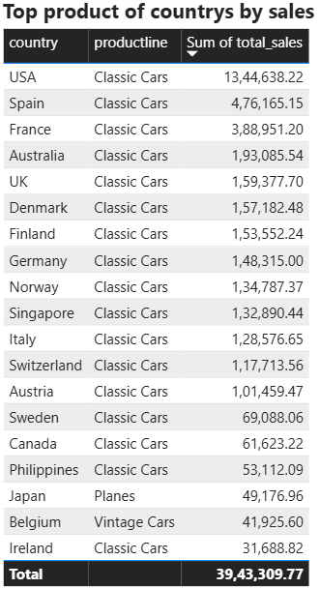
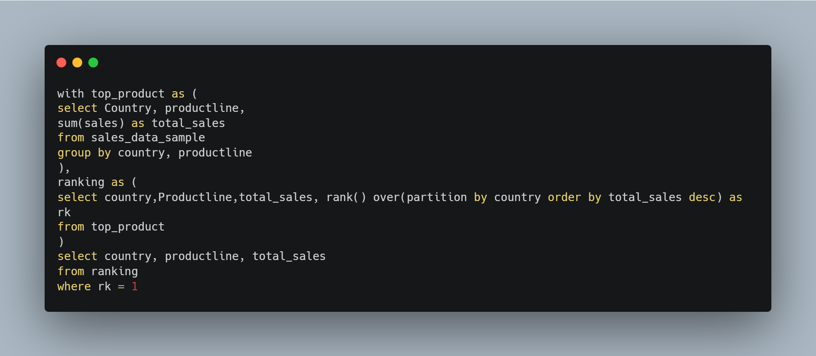
Classic Cars are the top-selling category across most countries
However, Japan shows higher preference for Planes, indicating regional variation
Business Implication
Implement region-specific product strategies
Customize offerings based on local demand patterns

Slide 8
Time-Based Analysis

Slide 9
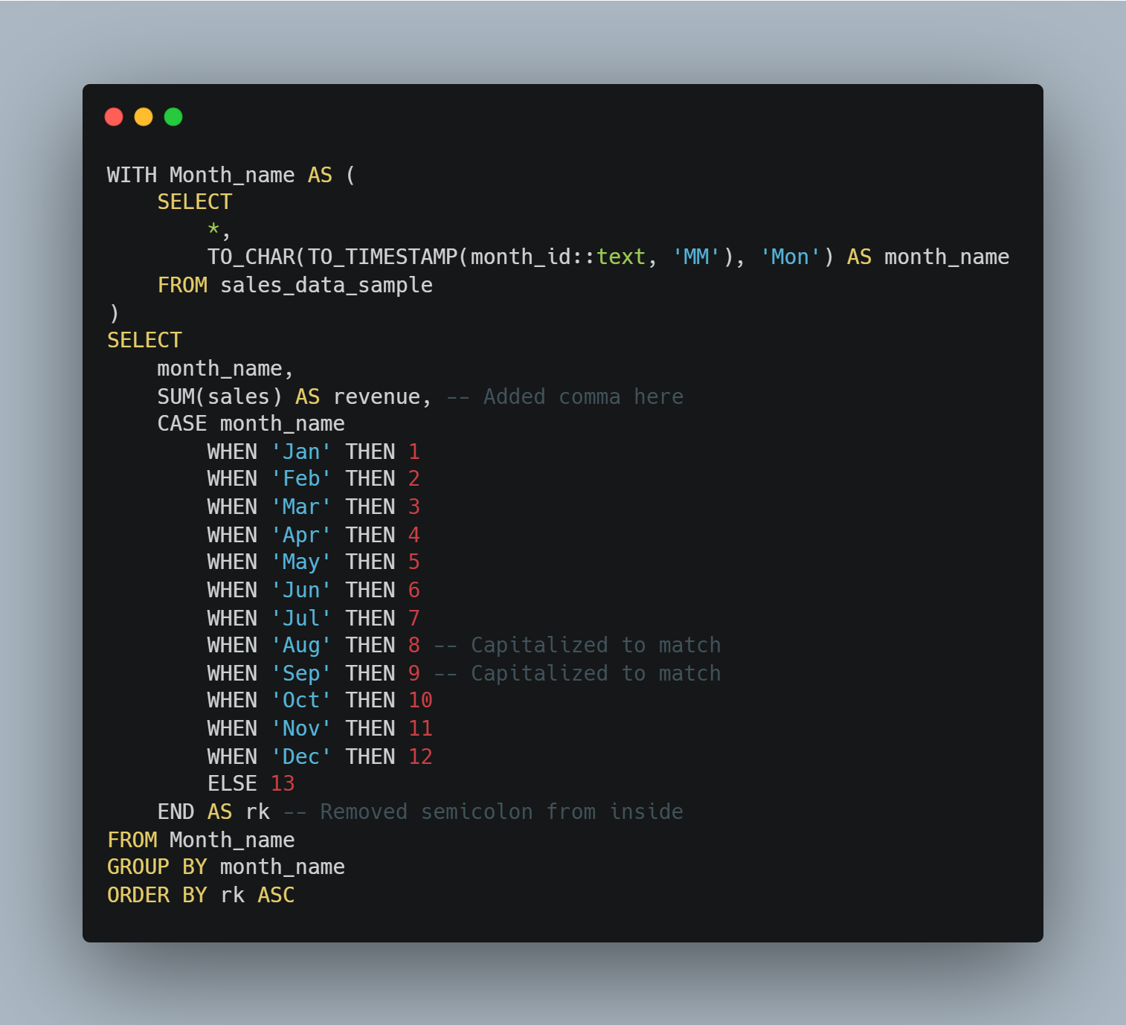
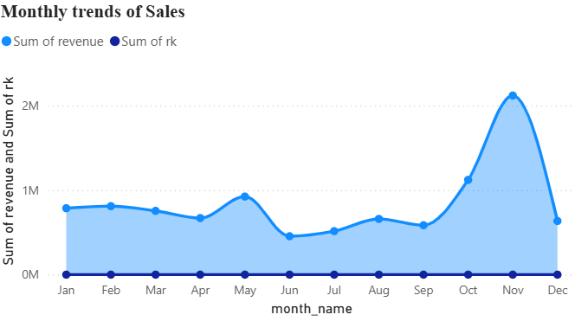
Peak sales occur in May, October and November
June shows noticeably lower sales performance
Business Implication
Plan marketing campaigns around high-performing months
Investigate reasons for low sales in June and apply corrective strategies

Slide 10
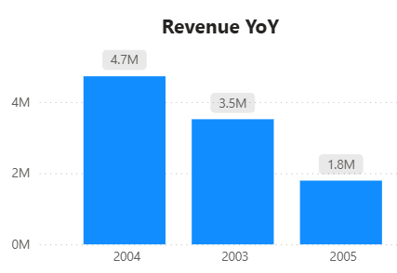
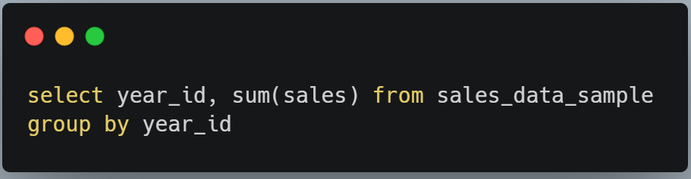
Revenue declined significantly from $4.7M in 2004 to $1.8M in 2005
Indicates a potential issue in demand, strategy, or operations
Business Implication
Requires further investigation into the cause of decline
Possible focus areas:
Customer retention
Product relevance
Market conditions

Slide 11
Key Business Recommendations
Focus on top-performing markets (USA, Spain, France)
Strengthen high-demand product lines (Classic Cars, Vintage Cars)
Implement region-specific product strategies
Improve customer retention for high-value customers
Investigate and address decline in yearly revenue
Optimize sales during low-performing months

